Slide 1
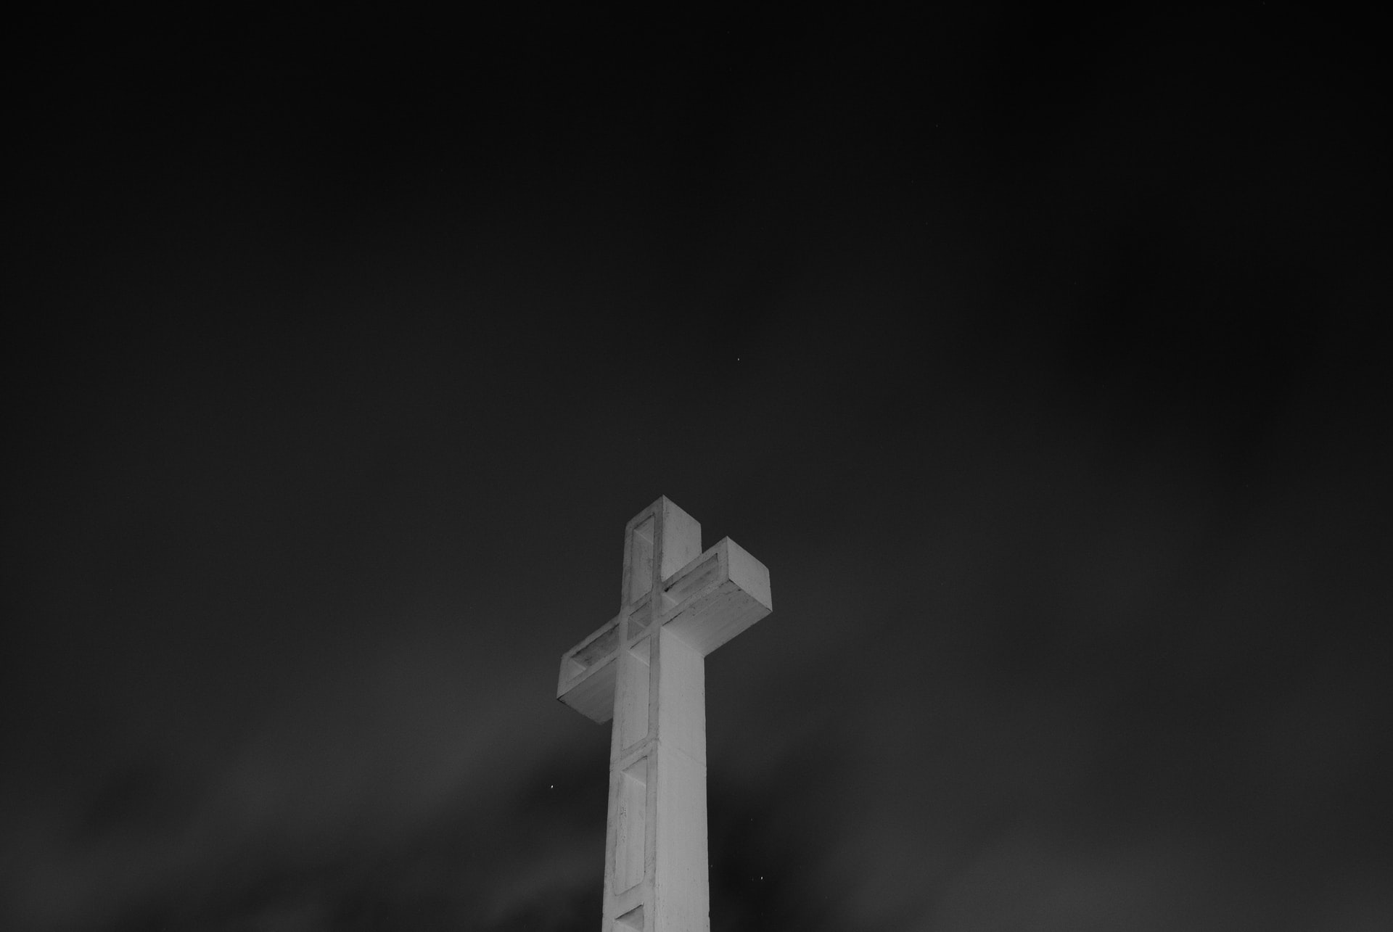
“Written about Me”

Slide 3
“Written about Me”

Slide 4
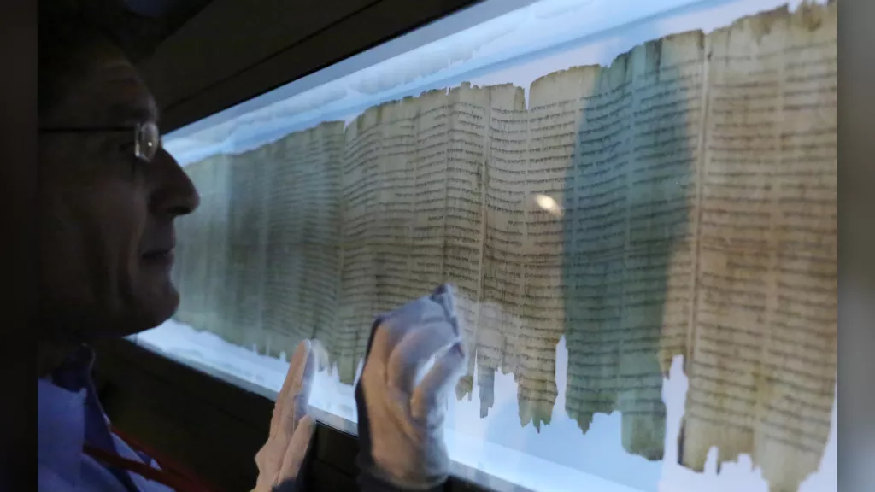

Slide 5
God gives a surprising summary about His
Servant who was to come (52:13-15).
A. God’s coming Servant would be wise
successful, and highly exalted (13).

Slide 6
God gives a surprising summary about His
Servant who was to come (52:13-15).
B. His appearance will be appalling (14).

Slide 7
God gives a surprising summary about His
Servant who was to come (52:13-15).
C. He will purify the nations (15).

Slide 8
God gives a surprising summary about His
Servant who was to come (52:13-15).
D. When the truth of who the Servant is dawns
upon the kings of the earth, they will not be
able to speak (15b).

Slide 9
The redeemed, in retrospect, tell about
the Servant (1-6).
A. Very few believed in Him (1-2).

Slide 10
The redeemed, in retrospect, tell about
the Servant (1-6).
B. We despised Him(3).

Slide 11
The redeemed, in retrospect, tell about
the Servant (1-6).
C. But now we understand that God was
striking Him instead of striking us (4-6).

Slide 12
Isaiah explains what the Servant would do (7-10).
A. He would willingly go to His own death
for us (7-8).

Slide 14
Isaiah explains what the Servant would do (7-10).
B. He would be buried (9).

Slide 15
Isaiah explains what the Servant would do (7-10).
C. After that He would live and prosper (10).

Slide 17
God will give His Servant what He has rightfully
earned (11-12).
A. God’s Servant will be satisfied with what
He sees (11).

Slide 18
God will give His Servant what He has rightfully
earned (11-12).
B. Many will now be counted righteous (11b).

Slide 20
God will give His Servant what He has rightfully
earned (11-12).
C. God will give the redeemed to Him as His
rightful portion, and God will give the mighty
to Him to dispose of as He chooses (12).

Slide 23
“Written about Me”

Slide 26
“Written about Me”

