Slide 1
Acts 6:8-7:19
Stephen’s Apology, (p.2):
Moses, God’s Chosen Redeemer

Slide 2
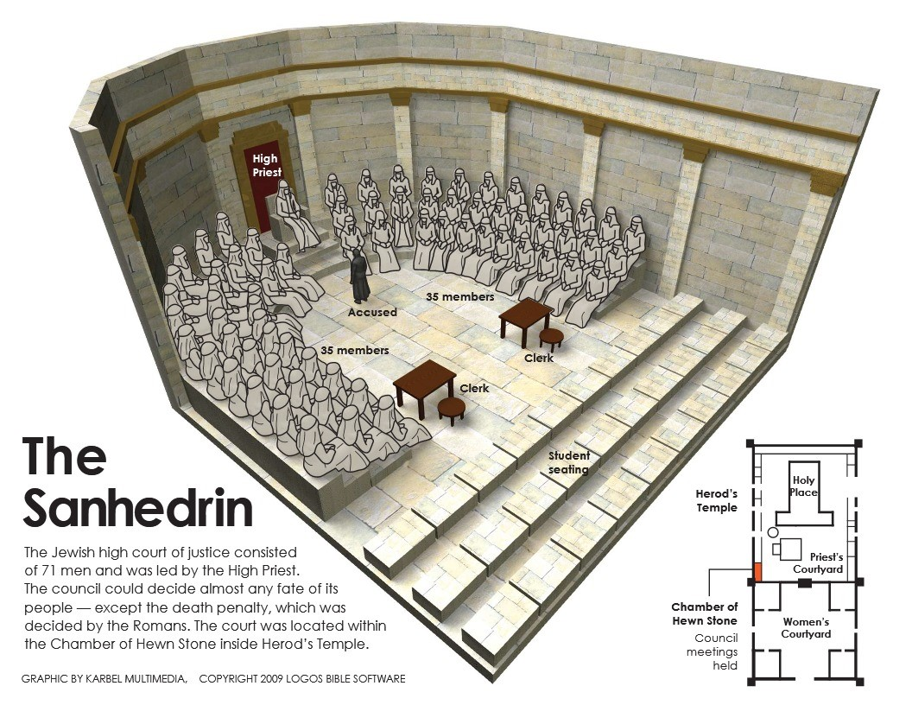
Stephen is (falsely) accused of blaspheming against:
1. Moses (Acts 6:11b)
2. God (Acts 6:11b)
3. The Temple (Acts 6:13b)
4. The Law (Acts 6:13b)
REVIEW:

Slide 3
Exodus 1 (ESV)
vv. 9-10. And he said to his people, “Behold, the people of Israel are too many and too mighty for us. Come, let us deal shrewdly with them, lest they multiply, and, if war breaks out, they join our enemies and fight against us and escape from the land.”
Like baby Jesus, God sovereignly rescued
baby Moses from
certain death.
vv. 16-17. “Then the king of Egypt said to the Hebrew midwives … When you serve as midwife to the Hebrew women and see them on the birthstool, if it is a son, you shall kill him, but if it is a daughter, she shall live.” But the midwives feared God and did not do as the king of Egypt commanded them, but let the male children live.
v.20. So God dealt well with the midwives. And the people multiplied and grew very strong.
v.22. Then Pharaoh commanded all his people, “Every son that is born to the Hebrews you shall cast into the Nile, but you shall let every daughter live.”

Slide 4
Romans 5:6 (ESV)
For while we were still weak, at the right time Christ died for the ungodly.
Like baby Jesus, God sovereignly rescued
baby Moses from
certain death.
Acts 2:23 (ESV)
this Jesus, delivered up according to the definite plan and foreknowledge of God, you crucified and killed by the hands of lawless men.
Matthew 2:16 (ESV)
Then Herod, when he saw that he had been tricked by the wise men, became furious, and he sent and killed all the male children in Bethlehem and in all that region who were two years old or under, according to the time that he had ascertained from the wise men.

Slide 5
Exodus 4 (ESV)
v.10. But Moses said to the LORD, “Oh, my Lord, I am not eloquent, either in the past or since you have spoken to your servant, but I am slow of speech and of tongue.”
v.1. Then Moses answered, “But behold, they will not believe me or listen to my voice, for they will say, ‘The LORD did not appear to you.’ ”
2. Like Jesus, Moses was
mighty in words and deeds.
v. 13. But he said, “Oh, my Lord, please send someone else.”
v. 14. Then the anger of the LORD was kindled against Moses
Luke 24:18-19 (ESV)
“Are you the only visitor to Jerusalem who does not know the things that have happened there in these days?” And he said to them, “What things?” And they said to him, “Concerning Jesus of Nazareth, a man who was a prophet mighty in deed and word before God and all the people,

Slide 6
Exodus 4:31 (ESV)
And the people believed; and when they heard that the LORD had visited the people of Israel and that he had seen their affliction, they bowed their heads and worshiped.
3. Like Jesus, Moses came
humbly the first time to
offer salvation … but was
rejected.
Psalm 8:4 (ESV)
what is man that you are mindful of him, and the son of man that you care for (visit) him?
Luke 1:68-69 (ESV)
Blessed be the Lord God of Israel, for he has visited and redeemed his people and has raised up a horn of salvation for us in the house of his servant David,

Slide 7
Luke 7:15-16 (ESV)
And the dead man sat up and began to speak, and Jesus gave him to his mother. Fear seized them all, and they glorified God, saying, “A great prophet has arisen among us!” and “God has visited his people!”
3. Like Jesus, Moses came
humbly the first time to
offer salvation … but was
rejected.
John 1:11 (ESV)
He came to his own, and his own people did not receive him.
Philippians 2:8 (ESV)
And being found in human form, he (Christ Jesus) humbled himself by becoming obedient to the point of death, even death on a cross.
1 Timothy 2:5 (ESV)
For there is one God, and there is one mediator between God and men, the man Christ Jesus,

Slide 8
Exodus 7:7 (ESV)
Now Moses was eighty years old, and Aaron eighty-three years old, when they spoke to Pharaoh.
4. Like Jesus, Moses was
God’s chosen redeemer.

Slide 9
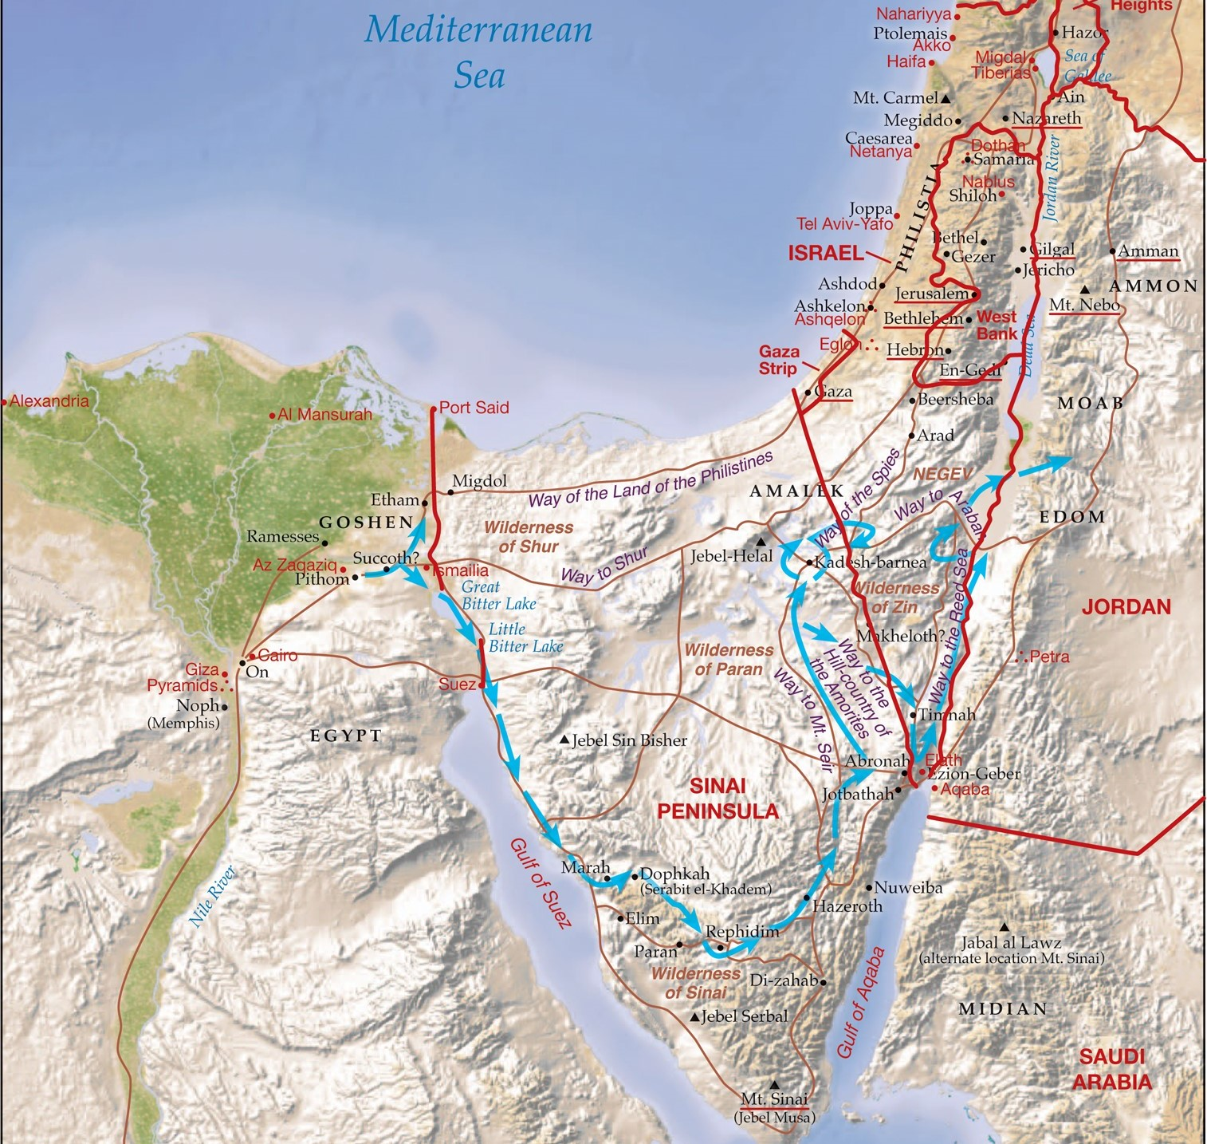
4. Like Jesus, Moses was
God’s chosen redeemer.

Slide 10
Exodus 7:7 (ESV)
Then Moses answered, “But behold, they will not believe me or listen to my voice, for they will say, ‘The LORD did not appear to you.’ ” The LORD said to him, “What is that in your hand?” He said, “A staff.” And he said, “Throw it on the ground.” So he threw it on the ground, and it became a serpent … “that they may believe that the LORD, the God of their fathers, the God of Abraham, the God of Isaac, and the God of Jacob, has appeared to you.” Again, the LORD said to him, “Put your hand inside your cloak.” And he put his hand inside his cloak, and when he took it out, behold, his hand was leprous like snow … “If they will not believe you,” God said, “or listen to the first sign, they may believe the latter sign. If they will not believe even these two signs or listen to your voice, you shall take some water from the Nile and pour it on the dry ground, and the water that you shall take from the Nile will become blood on the dry ground.”
4. Like Jesus, Moses was
God’s chosen redeemer.
Deuteronomy 34:7 (ESV)
Moses was 120 years old when he died. His eye was undimmed, and his vigor unabated.

Slide 11
John 5:36 (ESV)
But the testimony that I have is greater than that of John. For the works that the Father has given me to accomplish, the very works that I am doing, bear witness about me that the Father has sent me.
Mark 2:8-12 (ESV)
But that you may know that the Son of Man has authority on earth to forgive sins”—he said to the paralytic— “I say to you, rise, pick up your bed, and go home.” And he rose and immediately picked up his bed and went out before them all, so that they were all amazed and glorified God..”
Acts 2:22 (ESV)
“Men of Israel, hear these words: Jesus of Nazareth, a man attested to you by God with mighty works and wonders and signs that God did through him in your midst, as you yourselves know—
4. Like Jesus, Moses was
God’s chosen redeemer.

Slide 12
Galatians 3:13 (ESV)
Christ redeemed us from the curse of the law by becoming a curse for us—for it is written, “Cursed is everyone who is hanged on a tree”
Hebrews 9:15 (ESV)
Therefore he (Christ) is the mediator of a new covenant, so that those who are called may receive the promised eternal inheritance, since a death has occurred that redeems them from the transgressions committed under the first covenant.
4. Like Jesus, Moses was
God’s chosen redeemer.
1 Corinthians 15:56 (ESV)
The sting of death is sin, and the power of sin is the law.
Romans 7:10-11 (ESV)
The very commandment that promised life proved to be death to me. For sin, seizing an opportunity through the commandment, deceived me and through it killed me.

Slide 13
Romans 8:2 (ESV)
For the law of the Spirit of life has set you free in Christ Jesus from the law of sin and death.
4. Like Jesus, Moses was
God’s chosen redeemer.
Romans 8:3-4 (ESV)
For God has done what the law, weakened by the flesh, could not do. By sending his own Son in the likeness of sinful flesh and for sin, he condemned sin in the flesh, in order that the righteous requirement of the law might be fulfilled in us, who walk not according to the flesh but according to the Spirit.

Slide 14
John 5:24 (ESV)
Truly, truly, I say to you, whoever hears my word and believes him who sent me has eternal life. He does not come into judgment but has passed from death to life.
5. Like Jesus, Moses passed
down living words to
God’s people.
John 6:63 (ESV)
It is the Spirit who gives life; the flesh is no help at all. The words that I have spoken to you are spirit and life.
John 6:68 (ESV)
Simon Peter answered him, “Lord, to whom shall we go? You have the words of eternal life,

Slide 15
Acts 5:20 (ESV)
“Go … and speak to the people all the words of this Life.”
5. Like Jesus, Moses passed
down living words to
God’s people.

