Slide 1
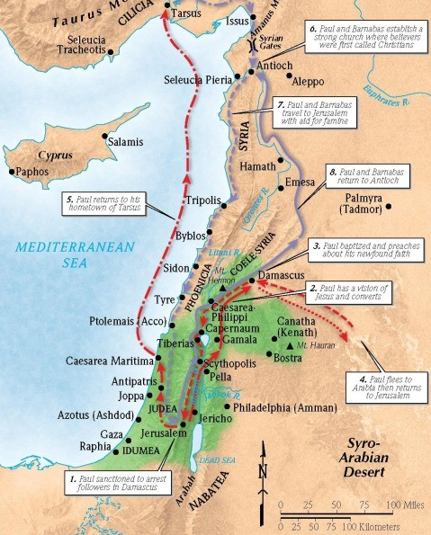
Saul:
Saved by Grace
Acts 9:1-9

Slide 2
1. You were once God’s enemy
Acts 6:9-10 (ESV)
Then some of those who belonged to the synagogue of the Freedmen (as it was called), and of the Cyrenians, and of the Alexandrians, and of those from Cilicia and Asia, rose up and disputed with Stephen. But they could not withstand the wisdom and the Spirit with which he was speaking.

Slide 3
1. You were once God’s enemy
Acts 7:58; 8:1a (ESV)
Then they cast him out of the city and stoned him. And the witnesses laid down their garments at the feet of a young man named Saul … And Saul approved of his execution.
Acts 8:1b, 3-4 (ESV)
… And there arose on that day a great persecution against the church in Jerusalem, and they were all scattered throughout the regions of Judea and Samaria, except the apostles … But Saul was ravaging the church, and entering house after house, he dragged off men and women and committed them to prison. Now those who were scattered went about preaching the word.

Slide 4
1. You were once God’s enemy
Acts 9:1 (ESV)
Breathing = Breathing IN.
Acts 9:2 (ESV)
Synagogues = plural

Slide 5
1. You were once God’s enemy
John 14:6 (ESV)
Jesus said to him, “I am the way, and the truth, and the life. No one comes to the Father except through me.
Isaiah 40:3 (ESV)
A voice cries: “In the wilderness prepare the way of the Lord; make straight in the desert a highway for our God.

Slide 6
1. You were once God’s enemy
Romans 5:10-11 (ESV)
For if while we were enemies we were reconciled to God by the death of his Son, much more, now that we are reconciled, shall we be saved by his life. More than that, we also rejoice in God through our Lord Jesus Christ, through whom we have now received reconciliation.
Philippians 3:18-19 (ESV)
For many, of whom I have often told you and now tell you even with tears, walk as enemies of the cross of Christ. Their end is destruction, their god is their belly, and they glory in their shame, with minds set on earthly things.

Slide 7
2. God chose you while you were in darkness
Acts 9:3 (NASB95)
As he was traveling, it happened that he was approaching Damascus, and suddenly a light from heaven flashed around him;
Acts 26:13 (ESV)
At midday, O king, I saw on the way a light from heaven, brighter than the sun, that shone around me and those who journeyed with me.

Slide 8
2. God chose you while you were in darkness
Luke 1:12-13 (ESV)
And Zechariah was troubled when he saw him, and fear fell upon him. But the angel said to him, “Do not be afraid, Zechariah, for your prayer has been heard, and your wife Elizabeth will bear you a son, and you shall call his name John.
Revelation 1:17 (ESV)
When I saw him, I fell at his feet as though dead. But he laid his right hand on me, saying, “Fear not, I am the first and the last …”

Slide 9
2. God chose you while you were in darkness
Luke 10:41 (ESV)
But the Lord answered her, “Martha, Martha, you are anxious and troubled about many things,
Luke 22:31-32a (ESV)
“Simon, Simon, behold, Satan demanded to have you, that he might sift you like wheat, but I have prayed for …”
Luke 13:34 (ESV)
O Jerusalem, Jerusalem, the city that kills the prophets and stones those who are sent to it! How often would I have gathered your children together as a hen gathers her brood under her wings, and you were not willing!

Slide 10
2. God chose you while you were in darkness
Romans 8:8 (ESV)
Those who are in the flesh cannot please God.
2 Corinthians 4:3-4 (ESV)
And even if our gospel is veiled, it is veiled to those who are perishing. In their case the god of this world has blinded the minds of the unbelievers, to keep them from seeing the light of the gospel of the glory of Christ, who is the image of God.
Ephesians 2:1 (ESV)
And you were dead in the trespasses and sins

Slide 11
2. God chose you while you were in darkness
2 Thessalonians 2:13 (NASB)
But we should always give thanks to God for you, brethren beloved by the Lord, because God has chosen you from the beginning for salvation through sanctification by the Spirit and faith in the truth.
Ephesians 1:3-4a (ESV)
Blessed be the God and Father of our Lord Jesus Christ, who has blessed us in Christ with every spiritual blessing in the heavenly places, even as he chose us in him before the foundation of the world …

Slide 12
3. Jesus died for sinners and is alive.
1 Corinthians 9:1 (ESV)
Am I not free? Am I not an apostle? Have I not seen Jesus our Lord? Are not you my workmanship in the Lord?
1 Corinthians 15:8 (ESV)
Last of all, as to one untimely born, he appeared also to me.

Slide 13
3. Jesus died for sinners and is alive.
Acts 26:14 (ESV)
And when we had all fallen to the ground, I heard a voice saying to me in the Hebrew language, ‘Saul, Saul, why are you persecuting me? It is hard for you to kick against the goads.’

Slide 14
3. Jesus died for sinners and is alive.
Acts 22:19-20 (ESV)
And I said, ‘Lord, they themselves know that in one synagogue after another I imprisoned and beat those who believed in you. And when the blood of Stephen your witness was being shed, I myself was standing by and approving and watching over the garments of those who killed him.’

Slide 15
3. Jesus died for sinners and is alive.
Romans 7:10 (ESV)
The very commandment that promised life proved to be death to me.
Romans 7:19 (ESV)
For I do not do the good I want, but the evil I do not want is what I keep on doing.

Slide 16
4. God continues His work in His stumbling saint.
Acts 22:8-10 (ESV)
And I answered, ‘Who are you, Lord?’ And he said to me, ‘I am Jesus of Nazareth, whom you are persecuting.’ Now those who were with me saw the light but did not understand the voice of the one who was speaking to me. And I said, ‘What shall I do, Lord?’ And the Lord said to me, ‘Rise, and go into Damascus, and there you will be told all that is appointed for you to do.’
Romans 10:9 (ESV)
because, if you confess with your mouth that Jesus is Lord and believe in your heart that God raised him from the dead, you will be saved.

Slide 17
4. God continues His work in His stumbling saint.
1 Corinthians 15:10 (ESV)
But by the grace of God I am what I am, and his grace toward me was not in vain. On the contrary, I worked harder than any of them, though it was not I, but the grace of God that is with me.
Philippians 2:12-13 (ESV)
Therefore, my beloved, as you have always obeyed, so now, not only as in my presence but much more in my absence, work out your own salvation with fear and trembling, for it is God who works in you, both to will and to work for his good pleasure.

