Slide 1
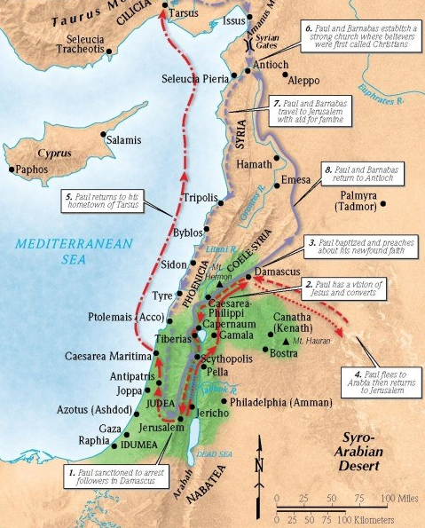
Saul:
A New Life Sold Out for Christ
Acts 9:19-31

Slide 2
1. Saul met with other Jesus followers
1 Corinthians 12:13-14 (ESV)
For in one Spirit we were all baptized into one body—Jews or Greeks, slaves or free—and all were made to drink of one Spirit. For the body does not consist of one member but of many.
Hebrews 10:24-25 (ESV)
And let us consider how to stir up one another to love and good works, not neglecting to meet together, as is the habit of some, but encouraging one another, and all the more as you see the Day drawing near.

Slide 3
2. Saul immediately preached Jesus.
Romans 1:1-4 (ESV)
Paul, a servant of Christ Jesus, called to be an apostle, set apart for the gospel of God, which he promised beforehand through his prophets in the holy Scriptures, concerning his Son, who was descended from David according to the flesh and was declared to be the Son of God in power according to the Spirit of holiness by his resurrection from the dead, Jesus Christ our Lord,
Psalm 51:12-13 (ESV)
Restore to me the joy of your salvation, and uphold me with a willing spirit. Then I will teach transgressors your ways, and sinners will return to you.

Slide 4
3. Saul wholly committed himself to Jesus’s words.
“increased” = passive tense
“Saul was being increased (by God) all the more”
1 Corinthians 3:6 (ESV)
I planted, Apollos watered, but God gave the growth.
Ephesians 3:16 (ESV)
that according to the riches of his glory he may grant you to be strengthened with power through his Spirit in your inner being.
“proving” = “to unite; to put facts together”

Slide 5
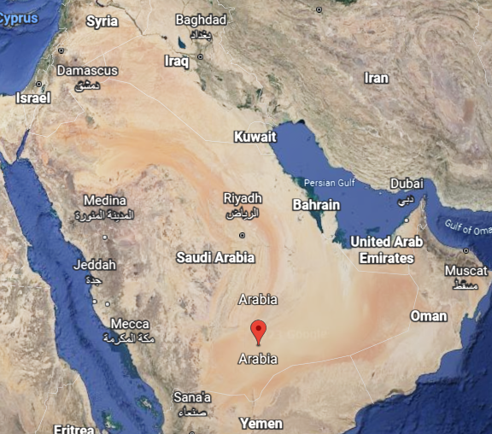
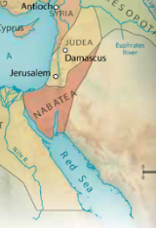

Slide 6
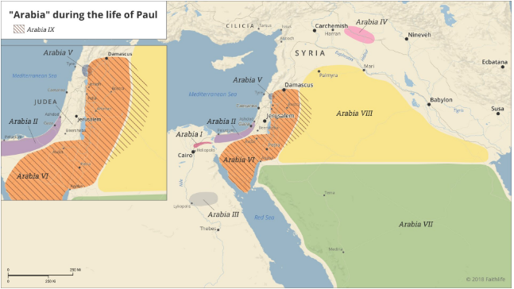

Slide 7
3. Saul wholly committed himself to Jesus’s words.
Acts 26:16 (ESV)
But rise and stand upon your feet, for I have appeared to you for this purpose, to appoint you as a servant and witness to the things in which you have seen me and to those in which I will appear to you,
.

Slide 8
4. Saul relentlessly sought fellowship with Jesus’s church.
Acts 4:35-37 (ESV)
Thus Joseph, who was also called by the apostles Barnabas (which means son of encouragement), a Levite, a native of Cyprus, sold a field that belonged to him and brought the money and laid it at the apostles’ feet.
Acts 14:14 (ESV)
But when the apostles Barnabas and Paul heard of it, they tore their garments and rushed out into the crowd, crying out,

Slide 9
5. Saul continued to preach Jesus no matter the cost.
Acts 22:17-21 (ESV)
“When I had returned to Jerusalem and was praying in the temple, I fell into a trance and saw him saying to me, ‘Make haste and get out of Jerusalem quickly, because they will not accept your testimony about me.’ And I said, ‘Lord, they themselves know that in one synagogue after another I imprisoned and beat those who believed in you. And when the blood of Stephen your witness was being shed, I myself was standing by and approving and watching over the garments of those who killed him.’ And he said to me, ‘Go, for I will send you far away to the Gentiles.’ ”

Slide 10
6. The church experienced peace and growth.
Ephesians 5:23-25 (ESV)
For the husband is the head of the wife even as Christ is the head of the church, his body, and is himself its Savior. Now as the church submits to Christ, so also wives should submit in everything to their husbands. Husbands, love your wives, as Christ loved the church and gave himself up for her,

