Slide 1
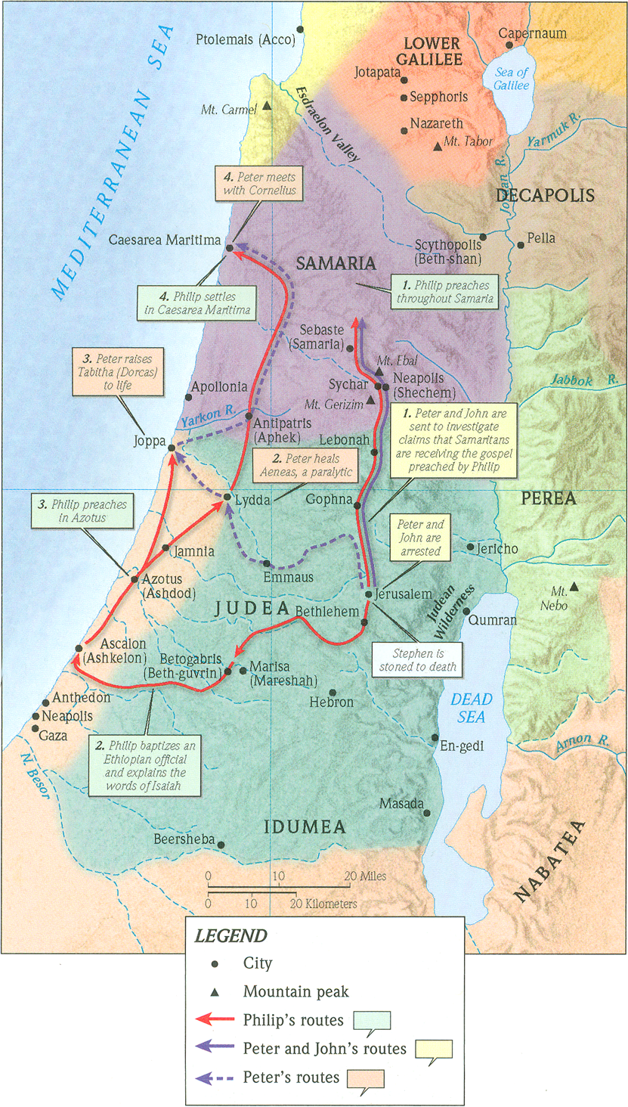
The Healing and Resurrecting Power of Jesus
Acts 9:32-43

Slide 2
1. The power of Jesus over disease
Matthew 8:14 (ESV)
And when Jesus entered Peter’s house, he saw his (Peter’s) mother-in-law lying sick with a fever.
1 Corinthians 9:5 (ESV)
Do we not have the right to take along a believing wife, as do the other apostles and the brothers of the Lord and Cephas (Peter)?

Slide 3
1. The power of Jesus over disease
The healing is
a. Empowered by Jesus.
b. Immediate and complete.
c. Undeniable and obvious.

Slide 4
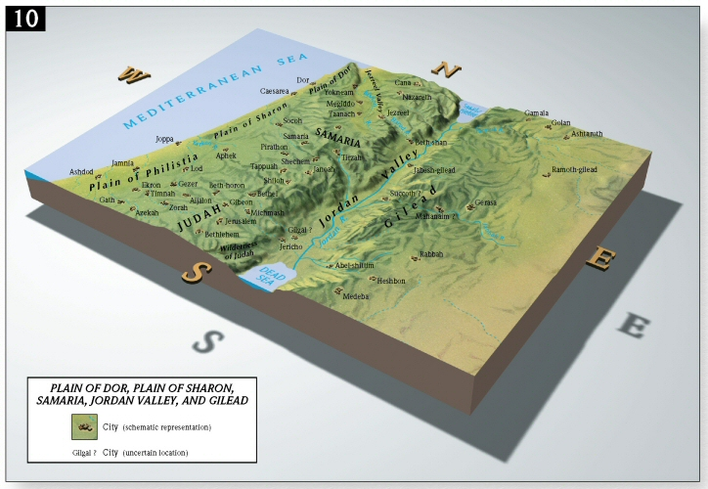

Slide 5
1. The power of Jesus over disease
The healing is
a. Empowered by Jesus.
b. Immediate and complete.
c. Undeniable and obvious.
d. Pointing people to Jesus

Slide 6
1. The power of Jesus over disease
Luke 17:18 (ESV)
and he fell on his face at Jesus’ feet, giving him thanks. Now he was a Samaritan. Then Jesus answered, “Were not ten cleansed? Where are the nine? Was no one found to return and give praise to God except this foreigner?” And he said to him, “Rise and go your way; your faith has made you well. (saved you.)”
Acts 2:22 (ESV)
“Men of Israel, hear these words: Jesus of Nazareth, a man attested to you by God with mighty works and wonders and signs that God did through him in your midst, as you yourselves know—

Slide 7
1. The power of Jesus over disease
John 5 (ESV)
vv.8-9a: Jesus said to him, “Get up, take up your bed, and walk.” and at once the man was healed…
v. 19: So Jesus said to them, “Truly, truly, I say to you, the Son can do nothing of his own accord, but only what he sees the Father doing.
v. 36b: the very works that I am doing, bear witness about me that the Father has sent me.

Slide 8
1. The power of Jesus over disease
Luke 9:1-2 (ESV)
And he called the twelve together and gave them power and authority over all demons and to cure diseases, and he sent them out to proclaim the kingdom of God and to heal.

Slide 9
1. The power of Jesus over disease
Ephesians 2:19b-20 (ESV)
…you are fellow citizens with the saints and members of the household of God, built on the foundation of the apostles and prophets, Christ Jesus himself being the cornerstone,

Slide 10
1. The power of Jesus over disease
2 Peter 1:2-3 (ESV)
May grace and peace be multiplied to you in the knowledge of God and (in the knowledge) of Jesus our Lord. His divine power has granted to us all things that pertain to life and godliness, through the knowledge of him who called us to his own glory and excellence,

Slide 11
1. The power of Jesus over disease
Colossians 1:17 (ESV)
And he (Jesus) is before all things, and in him all things hold together.
James 5:13-14a (ESV)
Is anyone among you suffering? Let him pray. Is anyone cheerful? Let him sing praise. Is anyone among you sick? Let him call for the elders of the church, and let them pray over him…

Slide 12
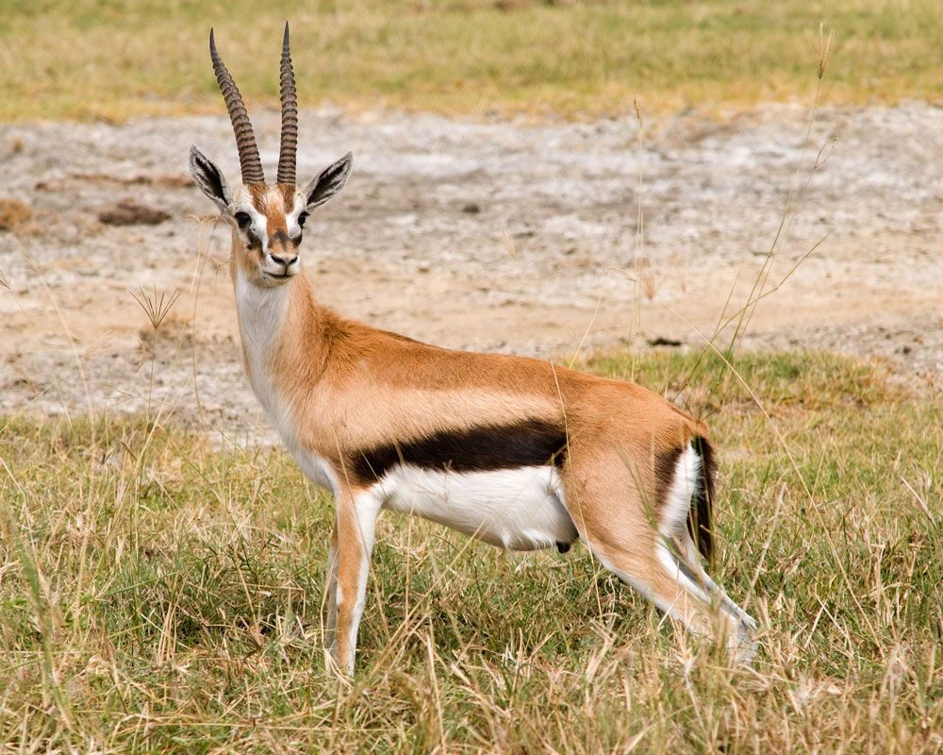
2. The power of Jesus over death.
Acts 8:40 (ESV)
But Philip found himself at Azotus, and as he passed through he preached the gospel to all the towns until he came to Caesarea.

Slide 13
2. The power of Jesus over death.
Proverbs 31:13-20 (ESV)
She seeks wool and flax, and works with willing hands. She is like the ships of the merchant; she brings her food from afar. She rises while it is yet night and provides food for her household and portions for her maidens. She considers a field and buys it; with the fruit of her hands she plants a vineyard. She dresses herself with strength and makes her arms strong. She perceives that her merchandise is profitable. Her lamp does not go out at night. She puts her hands to the distaff, and her hands hold the spindle. She opens her hand to the poor and reaches out her hands to the needy.
Ephesians 2:10 (ESV)
For we are his workmanship, created in Christ Jesus for good works, which God prepared beforehand, that we should walk in them.

Slide 14
2. The power of Jesus over death.
Matthew 10:5-8a (ESV)
These twelve Jesus sent out, instructing them, “Go nowhere among the Gentiles and enter no town of the Samaritans, but go rather to the lost sheep of the house of Israel. And proclaim as you go, saying, ‘The kingdom of heaven is at hand.’ Heal the sick, raise the dead, cleanse lepers, cast out demons…

Slide 15
3. The power of Jesus in salvation.
Luke 5:31 (ESV)
And Jesus answered them, “Those who are well have no need of a physician, but those who are sick.
Luke 5:32 (ESV)
I have not come to call the righteous but sinners to repentance.”

Slide 16
3. The power of Jesus in salvation.
a. You must turn to Jesus in repentance
b. You must believe in the Lord Jesus Christ
Romans 10:9 (ESV)
because, if you confess with your mouth that Jesus is Lord and believe in your heart that God raised him from the dead, you will be saved.
Romans 6:23 (ESV)
For the wages of sin is death, but the free gift of God is eternal life in Christ Jesus our Lord.

