Slide 1
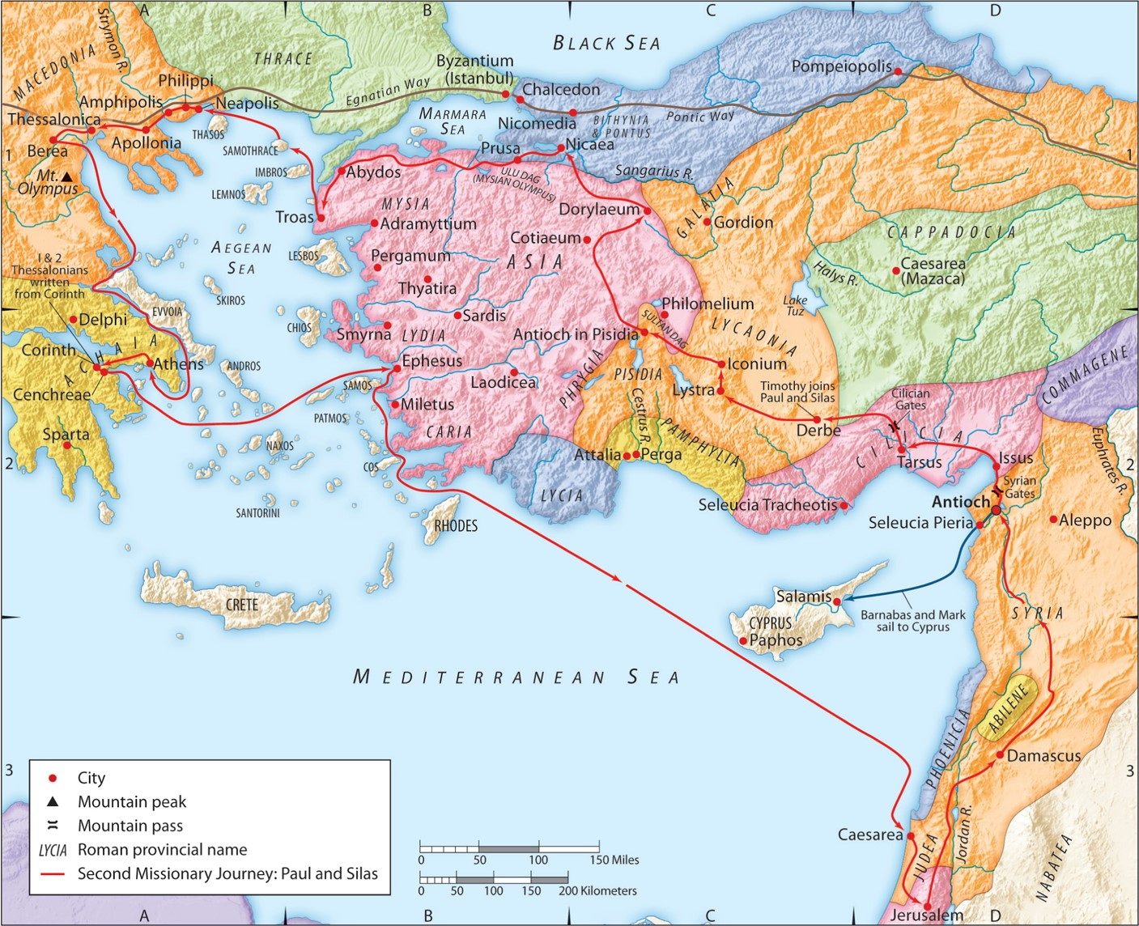
The Second Missionary Journey:
“Gospel Freedom for All”
(Part 3)
Acts 16:19-25
“Be my witnesses in Jerusalem and in all Judea and Samaria, and to the ends of the earth”
– Acts 1:8 (ESV)

Slide 2
Luke 17:17-19 (ESV)
Then Jesus answered, “Were not ten cleansed? Where are the nine? Was no one found to return and give praise to God except this foreigner?” And he said to him, “Rise and go your way; your faith has made you well.”

Slide 3
Romans 8:28 (ESV)
And we know that for those who love God all things work together for good, for those who are called according to his purpose.
Romans 8:29 (ESV)
For those whom he foreknew he also predestined to be conformed to the image of his Son, in order that he might be the firstborn among many brothers.

Slide 4
I. The city’s downhill response to God’s evident power.
A. The slave owners react angrily.
Ephesians 2:2b (ESV)
… following the prince of the power of the air, the spirit that is now at work in the sons of disobedience—

Slide 5
I. The city’s downhill response to God’s evident power.
A. The slave owners react angrily.
Acts 8:3 (ESV)
But Saul was ravaging the church, and entering house after house, he dragged off men and women and committed them to prison.

Slide 6
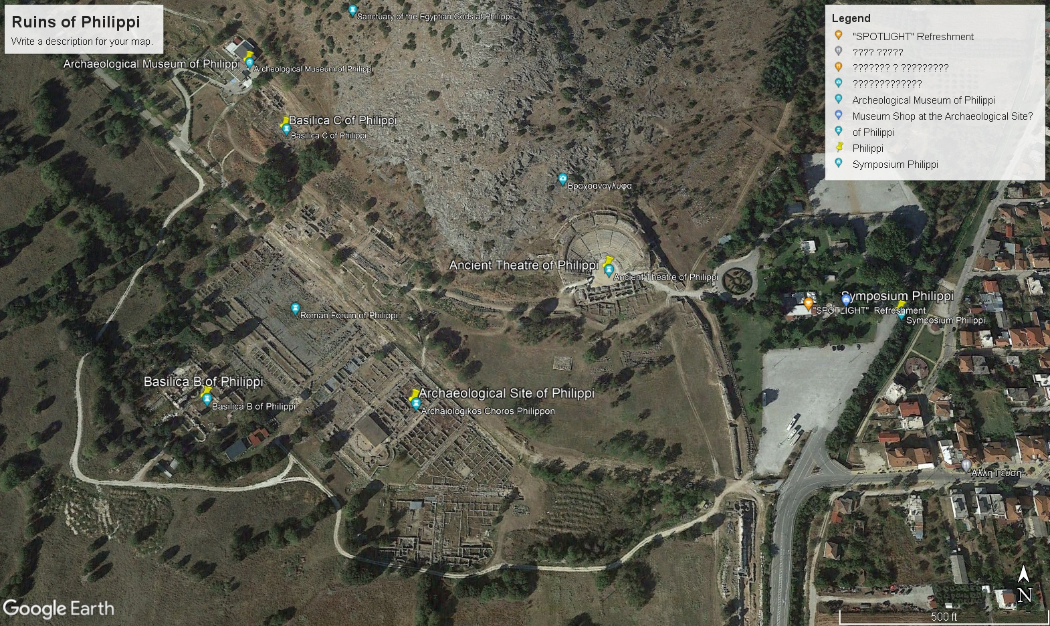

Slide 7
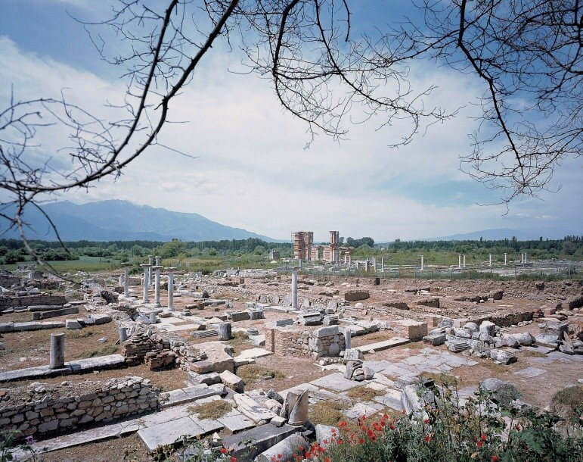

Slide 8
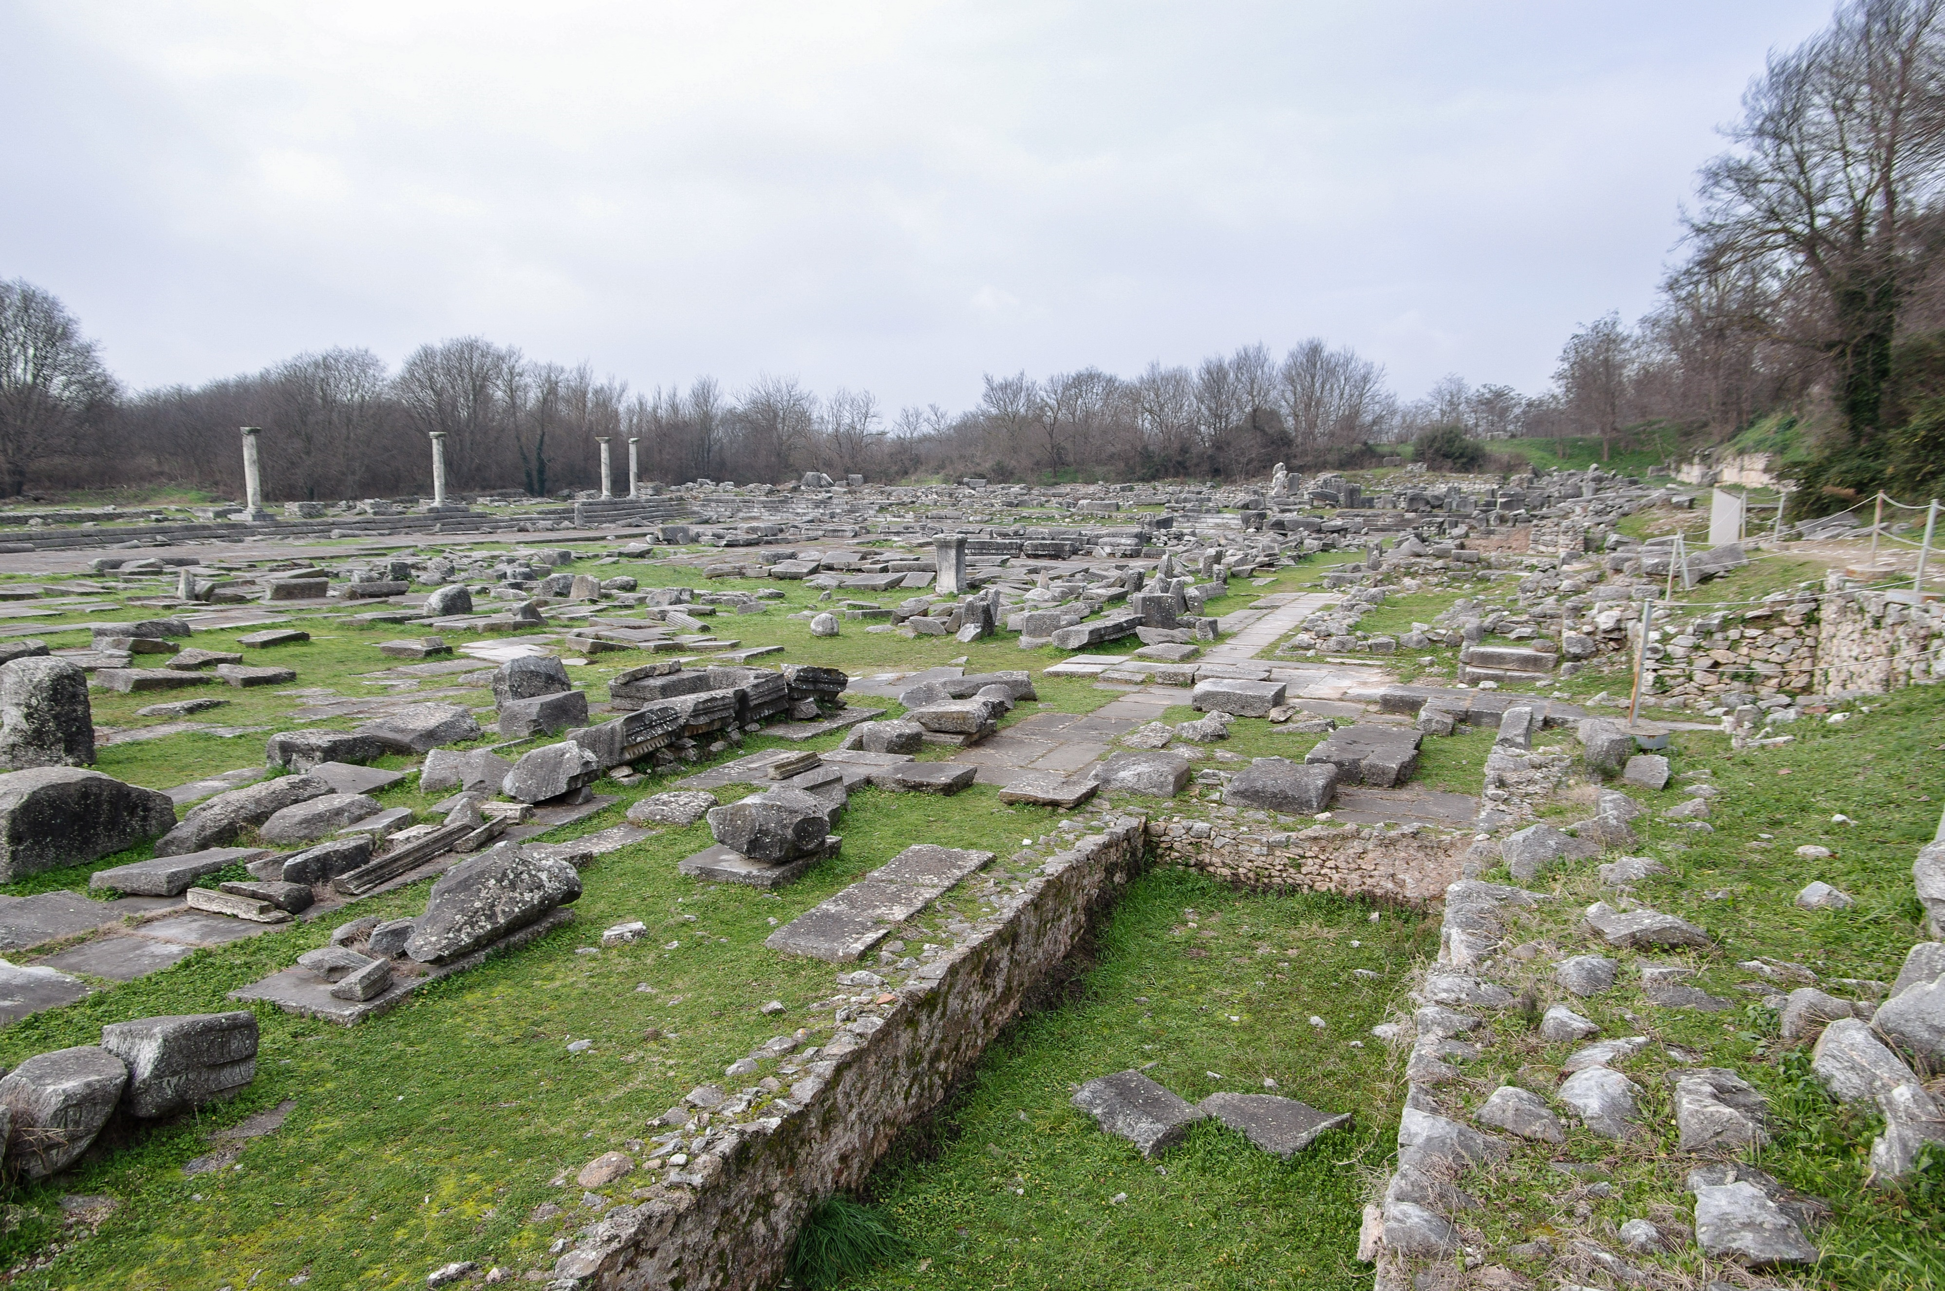
Bema
Stairs

Slide 9
I. The city’s downhill response to God’s evident power.
A. The slave owners react angrily.
1. They appeal to racial prejudice.
2. They appeal to Roman order.
3. They appeal to nationalism and traditionalism.

Slide 10
I. The city’s downhill response to God’s evident power.
B. The city crowd becomes an irrational mob.

Slide 11
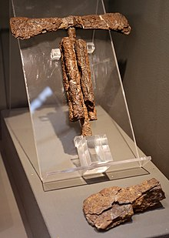
I. The city’s downhill response to God’s evident power.
C. The magistrates judge rashly, wrongly, and harshly.
2 Corinthians 11:24 (ESV)
Five times I received at the hands of the Jews the forty lashes less one.

Slide 12
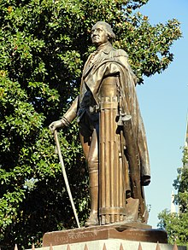
I. The city’s downhill response to God’s evident power.
C. The magistrates judge rashly, wrongly, and harshly.
2 Corinthians 11:24 (ESV)
Five times I received at the hands of the Jews the forty lashes less one.

Slide 13
I. The city’s downhill response to God’s evident power.
C. The magistrates judge rashly, wrongly, and harshly.
2 Corinthians 11:24 (ESV)
Five times I received at the hands of the Jews the forty lashes less one.
2 Corinthians 11:25 (ESV)
Three times I was beaten with rods. Once I was stoned. Three times I was shipwrecked; a night and a day I was adrift at sea;
2 Corinthians 11:23 (ESV)
Are they servants of Christ? I am a better one—I am talking like a madman—with far greater labors, far more imprisonments, with countless beatings, and often near death.

Slide 14
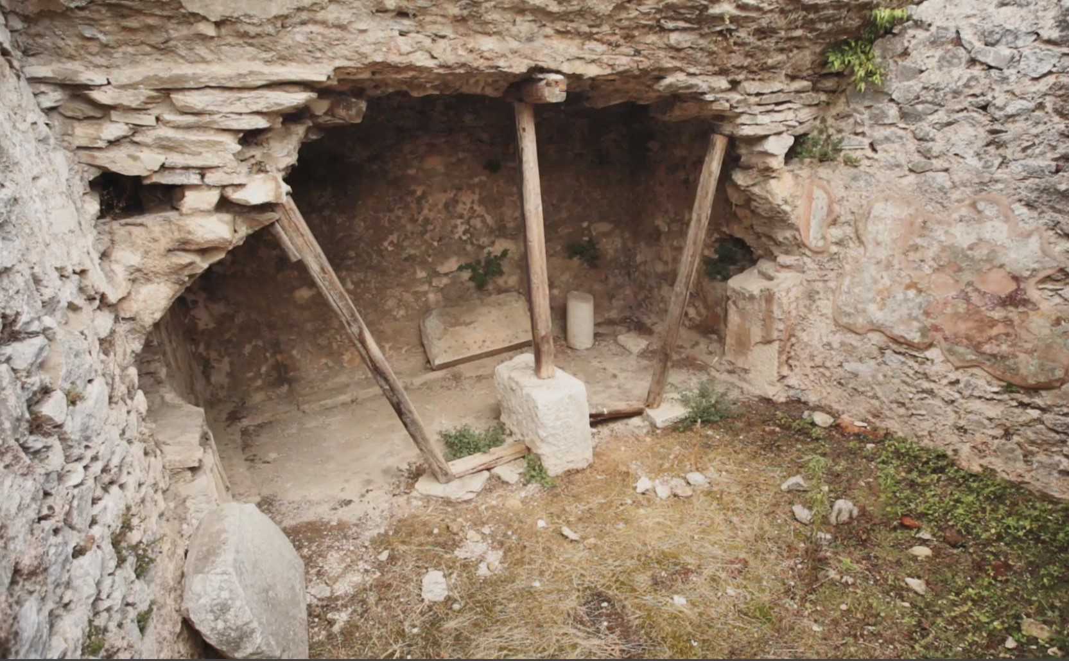

Slide 15
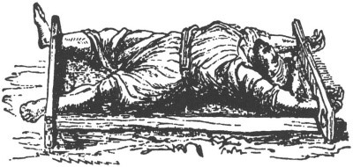

Slide 16
I. Paul and Silas’ upwards response to imprisonment.
A. They didn’t get angry or blame God.

Slide 17
I. Paul and Silas’ upwards response to imprisonment.
B. They prayed and sang hymns to God.
Romans 8:28-29 (ESV)
And we know that for those who love God all things work together for good, for those who are called according to his purpose. For those whom he foreknew he also predestined to be conformed to the image of his Son, in order that he might be the firstborn among many brothers.

Slide 18
I. Paul and Silas’ upwards response to imprisonment.
B. They prayed and sang hymns to God.
Ephesians 5:18b-19 (ESV)
Be filled with the Spirit, addressing one another in psalms and hymns and spiritual songs, singing and making melody to the Lord with your heart,
Colossians 3:16 (ESV)
Let the word of Christ dwell in you richly, teaching and admonishing one another in all wisdom, singing psalms and hymns and spiritual songs, with thankfulness in your hearts to God.

Slide 19
I. Paul and Silas’ upwards response to imprisonment.
C. This was a witness to all who heard.
Philippians 1:12-13 (ESV)
I want you to know, brothers, that what has happened to me has really served to advance the gospel, so that it has become known throughout the whole imperial guard and to all the rest that my imprisonment is for Christ.
Colossians 4:3 (ESV)
At the same time, pray also for us, that God may open to us a door for the word, to declare the mystery of Christ, on account of which I am in prison—
1 Thessalonians 2:2-4 (ESV)
But though we had already suffered and been shamefully treated at Philippi, as you know, we had boldness in our God to declare to you the gospel of God in the midst of much conflict. For our appeal does not spring from error or impurity or any attempt to deceive, but just as we have been approved by God to be entrusted with the gospel, so we speak, not to please man, but to please God who tests our hearts.

