Slide 1
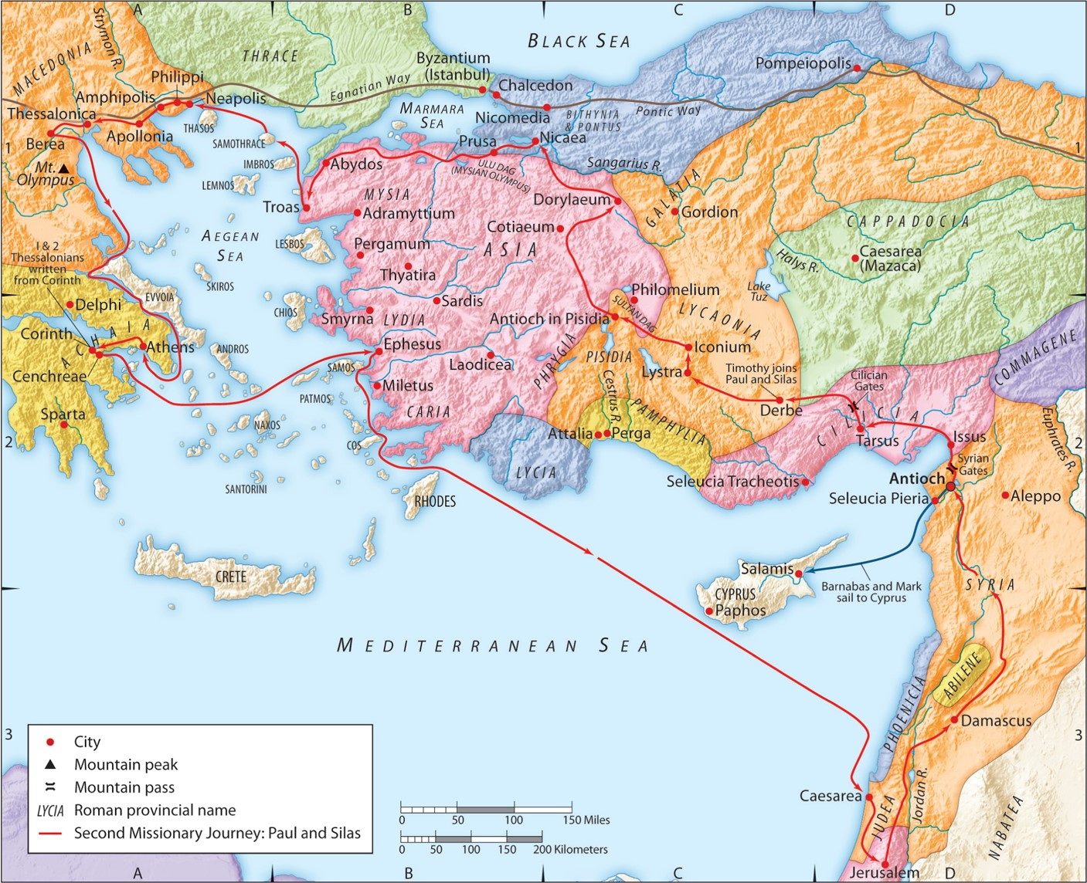
The Second Missionary Journey:
“The Penetrating Light
of God’s Word”
Acts 17:1-10
“Be my witnesses in Jerusalem and in all Judea and Samaria, and to the ends of the earth”
– Acts 1:8 (ESV)

Slide 2
Psalm 119:105 (ESV)
Your word is a lamp to my feet and a light to my path.
Romans 10:14 (ESV)
How then will they call on him in whom they have not believed? And how are they to believe in him of whom they have never heard? And how are they to hear without someone preaching?

Slide 3
A. God’s word provides everything you need to be His witness.
1 Thessalonians 3:1-2 (ESV)
Therefore when we could bear it no longer, we were willing to be left behind at Athens alone, and we sent Timothy, our brother and God’s coworker in the gospel of Christ, to establish and exhort you in your faith,

Slide 4
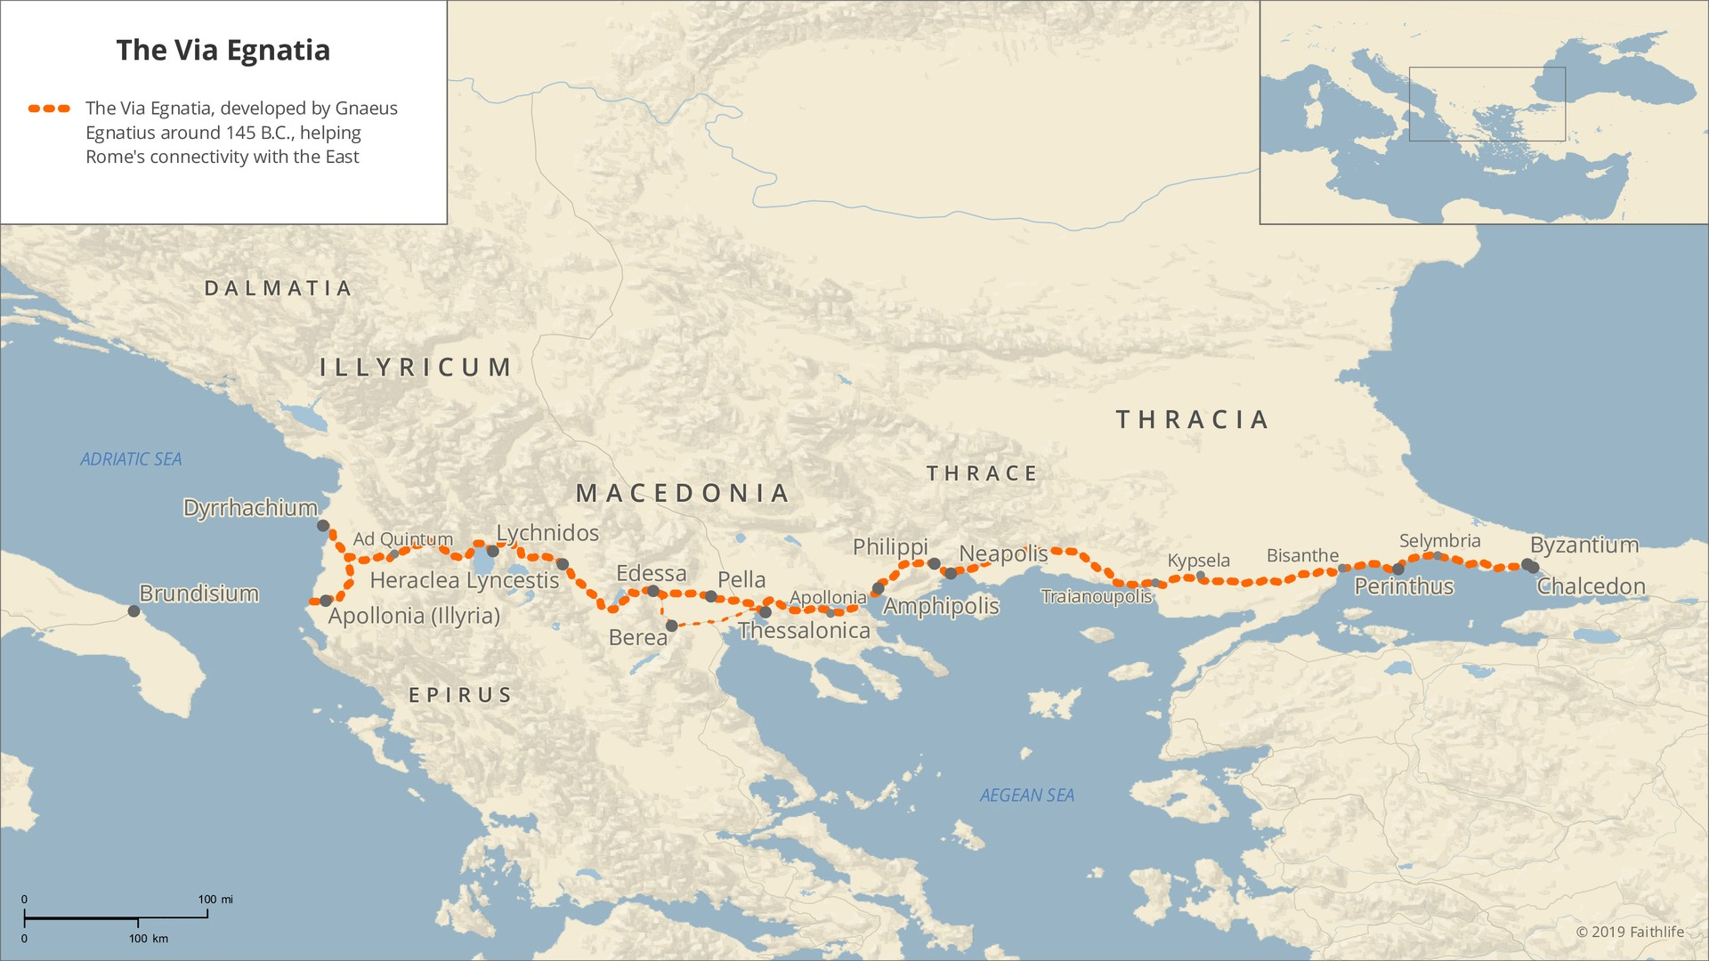

Slide 5
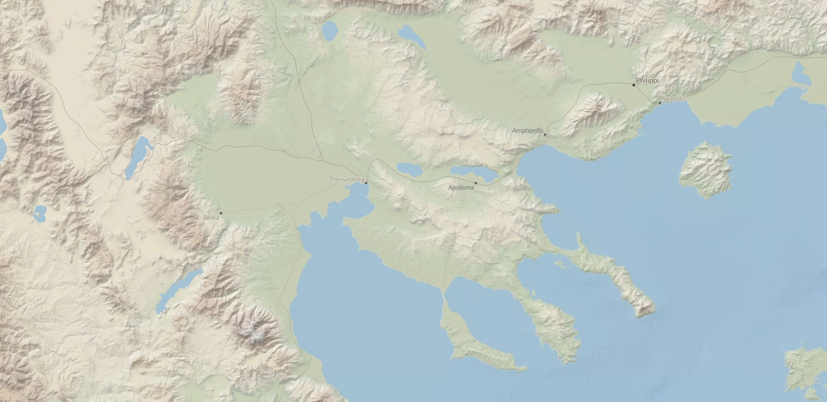

Slide 6
A. God’s word provides everything you need to be His witness.
Philippians 4:15-16 (ESV)
And you Philippians yourselves know that in the beginning of the gospel, when I left Macedonia, no church entered into partnership with me in giving and receiving, except you only. Even in Thessalonica you sent me help for my needs once and again.
1 Thessalonians 2:9 (ESV)
For you remember, brothers, our labor and toil: we worked night and day, that we might not be a burden to any of you, while we proclaimed to you the gospel of God.
2 Thessalonians 3:7-8 (ESV)
you yourselves know how you ought to imitate us, because we were not idle when we were with you, nor did we eat anyone’s bread without paying for it, but with toil and labor we worked night and day, that we might not be a burden to any of you.
1 Thessalonians 1:9 (ESV)
For they themselves report concerning us the kind of reception we had among you, and how you turned to God from idols to serve the living and true God,

Slide 7
A. God’s word provides everything you need to be His witness.
1. God’s word provides the defense you need.
(ESV) “Reasoned” = (gr) dialexato = “through the word” = (eng) “dialogue”
1 Peter 3:15 (ESV)
but in your hearts honor Christ the Lord as holy, always being prepared to make a defense to anyone who asks you for a reason for the hope that is in you; yet do it with gentleness and respect,

Slide 8
A. God’s word provides everything you need to be His witness.
1. God’s word provides the defense you need.
(ESV) “Reasoned” = (gr) dialexato = “through the word” = (eng) “dialogue”
Luke 12:11-12 (ESV)
And when they bring you before the synagogues and the rulers and the authorities, do not be anxious about how you should defend yourself or what you should say, for the Holy Spirit will teach you in that very hour what you ought to say.”
Exodus 4:10 (ESV)
But Moses said to the LORD, “Oh, my Lord, I am not eloquent, either in the past or since you have spoken to your servant, but I am slow of speech and of tongue.”
Exodus 4:11-12 (ESV)
Then the LORD said to him, “Who has made man’s mouth? Who makes him mute, or deaf, or seeing, or blind? Is it not I, the LORD? Now therefore go, and I will be with your mouth and teach you what you shall speak.”

Slide 9
A. God’s word provides everything you need to be His witness.
1. God’s word provides the defense you need.
(ESV) “Reasoned” = (gr) dialexato = “through the word” = (eng) “dialogue”
2 Peter 1:3 (ESV)
His divine power has granted to us all things that pertain to life and godliness, through the knowledge of him who called us to his own glory and excellence,

Slide 10
A. God’s word provides everything you need to be His witness.
1. God’s word provides the defense you need.
(ESV) “Reasoned” = (gr) dialexato = “through the word” = (eng) “dialogue”
2 Peter 1:3 (ESV)
His divine power has granted to us all things that pertain to life and godliness, through the knowledge of him who called us to his own glory and excellence,
2 Timothy 3:16-17 (ESV)
All Scripture is breathed out by God and profitable for teaching, for reproof, for correction, and for training in righteousness, that the man of God may be complete, equipped for every good work.
Exodus 4:11-12 (ESV)
For no prophecy was ever produced by the will of man, but men spoke from God as they were carried along by the Holy Spirit.

Slide 11
A. God’s word provides everything you need to be His witness.
1. God’s word provides the defense you need.
2. God’s word provides the answers you need.
Ephesians 6:17 (ESV)
and take the helmet of salvation, and the sword of the Spirit, which is the word of God,
Hebrews 4:12 (ESV)
For the word of God is living and active, sharper than any two-edged sword, piercing to the division of soul and of spirit, of joints and of marrow, and discerning the thoughts and intentions of the heart.

Slide 12
A. God’s word provides everything you need to be His witness.
1. God’s word provides the defense you need.
2. God’s word provides the answers you need.
3. God’s word provides the proof you need.

Slide 13
A. God’s word provides everything you need to be His witness.
1. God’s word provides the defense you need.
2. God’s word provides the answers you need.
3. God’s word provides the proof you need.
4. God’s word provides salvation through Jesus Christ.
John 5:39-40 (ESV)
You search the Scriptures because you think that in them you have eternal life; and it is they that bear witness about me, yet you refuse to come to me that you may have life.

Slide 14
A. God’s word provides everything you need to be His witness.
1. God’s word provides the defense you need.
2. God’s word provides the answers you need.
3. God’s word provides the proof you need.
4. God’s word provides salvation through Jesus Christ.
Romans 3:23 (ESV)
for all have sinned and fall short of the glory of God,
James 2:10 (ESV)
For whoever keeps the whole law but fails in one point has become guilty of all of it.
Romans 6:23 (ESV)
For the wages of sin is death, but the free gift of God is eternal life in Christ Jesus our Lord.

Slide 15
B. God’s works through you but He alone is sovereign.
1. Trust God to use His word for the work of salvation.
Romans 10:17(ESV)
So faith comes from hearing, and hearing through the word of Christ.
2 Corinthians 11:6 (ESV)
Even if I am unskilled in speaking, I am not so in knowledge; indeed, in every way we have made this plain to you in all things.
1 Corinthians 2:1-5 (ESV)
And I, when I came to you, brothers, did not come proclaiming to you the testimony of God with lofty speech or wisdom. For I decided to know nothing among you except Jesus Christ and him crucified. And I was with you in weakness and in fear and much trembling, and my speech and my message were not in plausible words of wisdom, but in demonstration of the Spirit and of power, so that your faith might not rest in the wisdom of men but in the power of God.

Slide 16
B. God’s works through you but He alone is sovereign.
1. Trust God to use His word for the work of salvation.
1 Thessalonians 1:2-5 (ESV)
We give thanks to God always for all of you, constantly mentioning you in our prayers, remembering before our God and Father your work of faith and labor of love and steadfastness of hope in our Lord Jesus Christ. For we know, brothers loved by God, that he has chosen you, because our gospel came to you not only in word, but also in power and in the Holy Spirit and with full conviction. You know what kind of men we proved to be among you for your sake.

Slide 17
B. God’s works through you but He alone is sovereign.
1. Trust God to use His word for the work of salvation.
2. Trust God to use His word even when others oppose you for it.
Romans 16:21 (ESV)
Timothy, my fellow worker, greets you; so do Lucius and Jason and Sosipater, my kinsmen.

Slide 18
B. God’s works through you but He alone is sovereign.
1. Trust God to use His word for the work of salvation.
2. Trust God to use His word even when others oppose you for it.
Luke 23:2 (ESV)
And they began to accuse him, saying, “We found this man misleading our nation and forbidding us to give tribute to Caesar, and saying that he himself is Christ, a king.”
Luke 23:36-38 (ESV)
The soldiers also mocked him, coming up and offering him sour wine and saying, “If you are the King of the Jews, save yourself!” There was also an inscription over him, “This is the King of the Jews.”

Slide 19
B. God’s works through you but He alone is sovereign.
1. Trust God to use His word for the work of salvation.
2. Trust God to use His word even when others oppose you for it.
1 Thessalonians 1:6-8 (ESV)
And you became imitators of us and of the Lord, for you received the word in much affliction, with the joy of the Holy Spirit, so that you became an example to all the believers in Macedonia and in Achaia. For not only has the word of the Lord sounded forth from you in Macedonia and Achaia, but your faith in God has gone forth everywhere, so that we need not say anything.

